Slide 1

Market Basket Analysis

Slide 2
What is Market Basket Analysis?
Market Basket Analysis is one of the key techniques used to uncover links between items by large retailers.
It works by searching for combinations of items that often happen in transactions together.
In a different way, retailers can identify relations among the items they buy.
It is a method of identifying object associations that “go together” in a commercial context.

Slide 3

Objective
Association rules are widely used to analyse retail basket or transaction data, with the objective of establishing strong rules based on a strong transaction information rules concept.

Slide 4
Market Basket Analysis uses the information to:
Capable of recognizing customer purchasing patterns
To identify who customers are(not by name)
Understand why you buy certain items

Slide 5
Learn about your goods (products):
Slow movements fast and slow
Products that are jointly purchased
Products that could be promoted

Slide 6
Action to take:
Layouts Store
What special products, promotions, coupons.

Slide 7
We would like to respond ideally to questions such as
What products are purchased jointly?
Which products could be promoted?
What are the best opportunities for cross-selling?

Slide 8
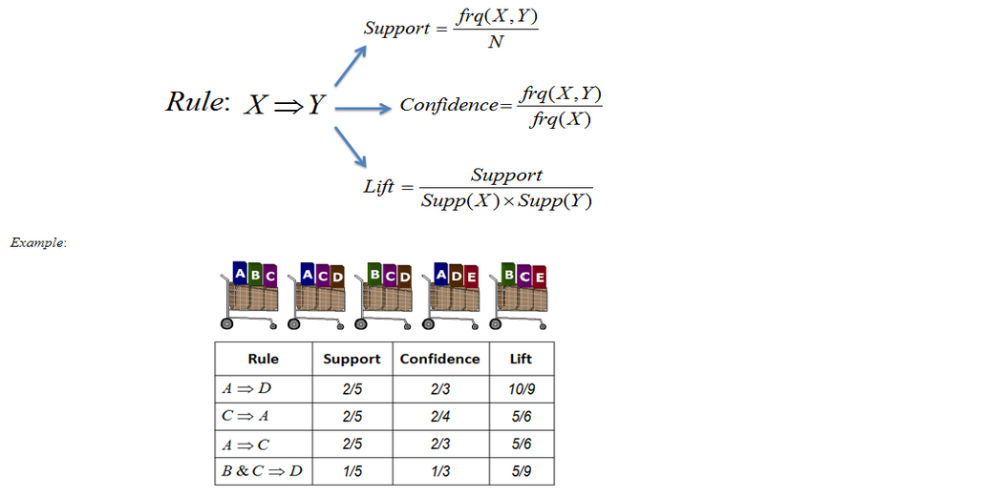
How is Market Basket Analysis used?

Slide 9
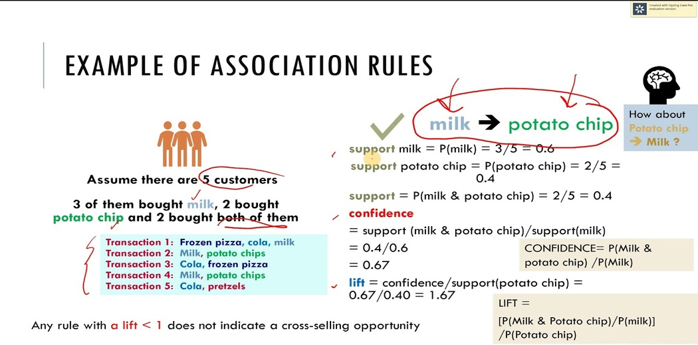

Slide 10
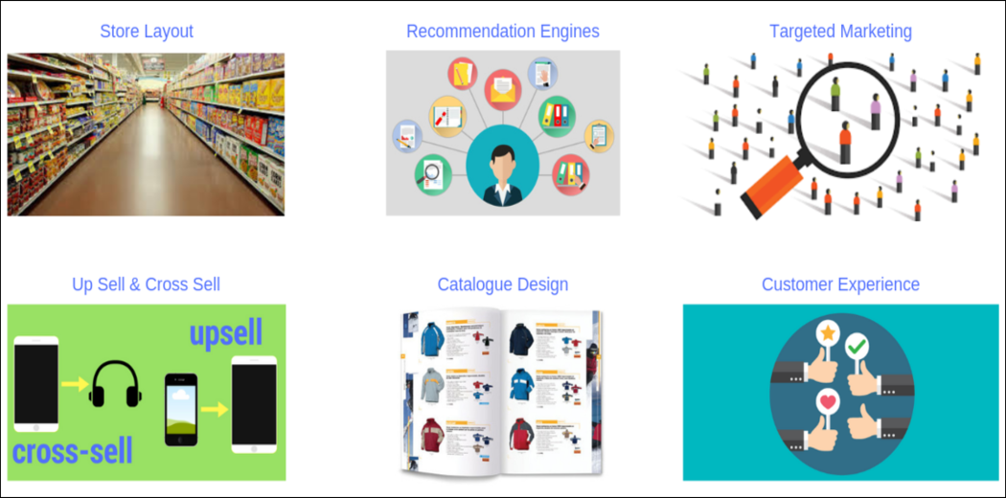
Applications

Slide 11
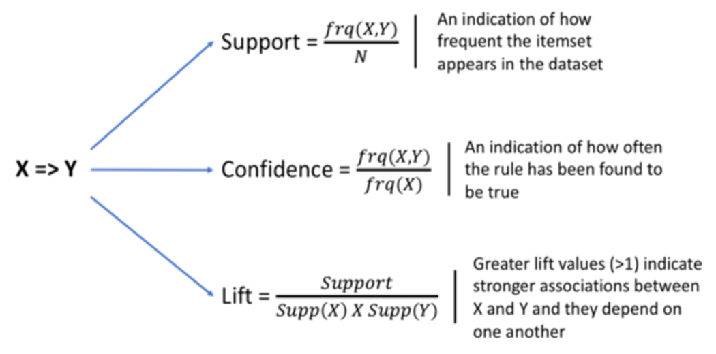
A Little Bit of Math

Slide 12
Questions?
Rajesh.19435@lpu.co.in

